Slide 1




SAEISS ADDC 2025
TECHANICAL PRESENTATION
TEAM PHOENIX AERO
TEAM ID:ADDC2025031
TEAM PHOENIX AERO

Slide 2
INTRODUCTION
Objective:
Develop an autonomous drone for safe and secure medical supply
Key points:
Frame and structural design
Payload mechanism
Automation
TEAM PHOENIX AERO

Slide 3
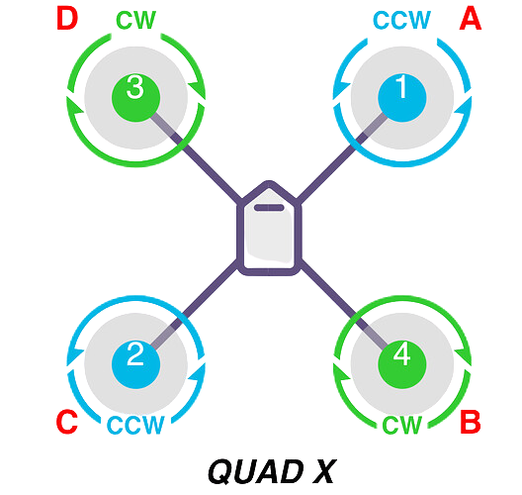
CONFIGURATION
Quad-X configuration is preferred due to its advantages:
Reduces drag and maximizes thrust
Uses differential thrust for yaw, pitch, and, roll
Ensures uniform flight with high motor efficiency
TEAM PHOENIX AERO

Slide 4
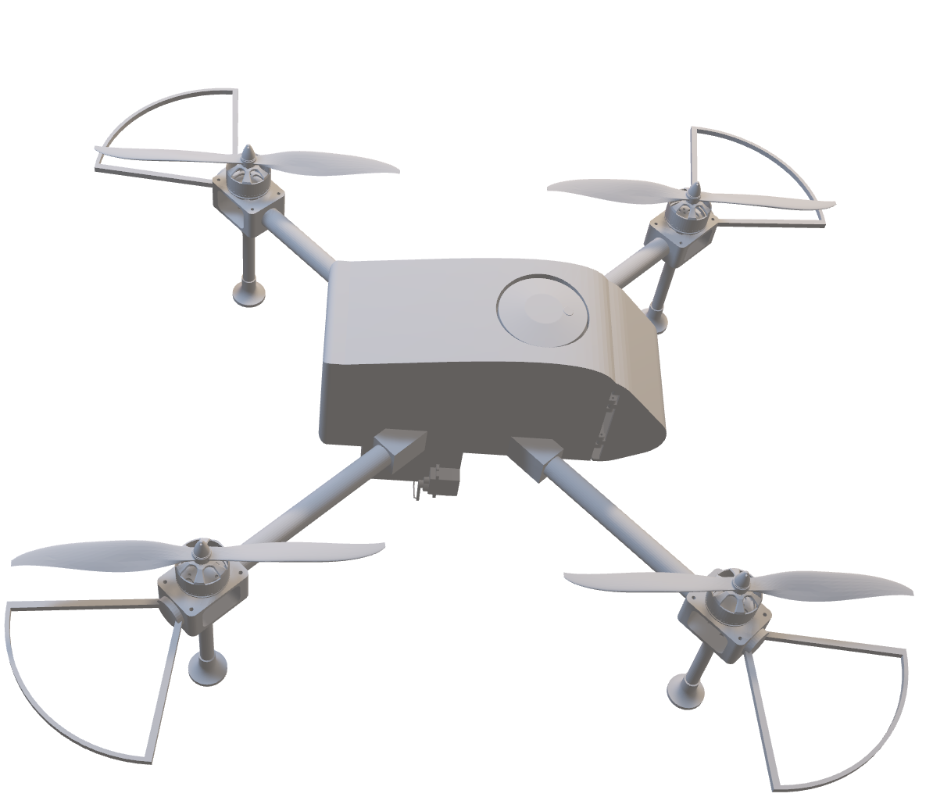
AERIAL DESIGN
TEAM PHOENIX AERO

Slide 5
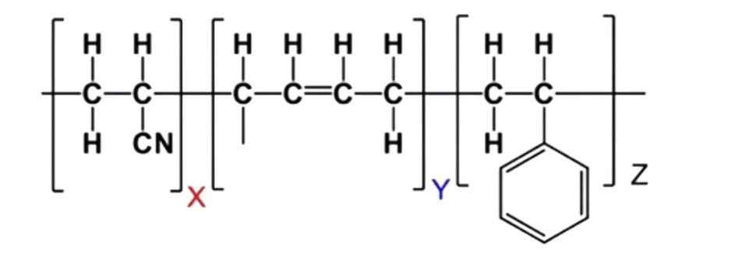
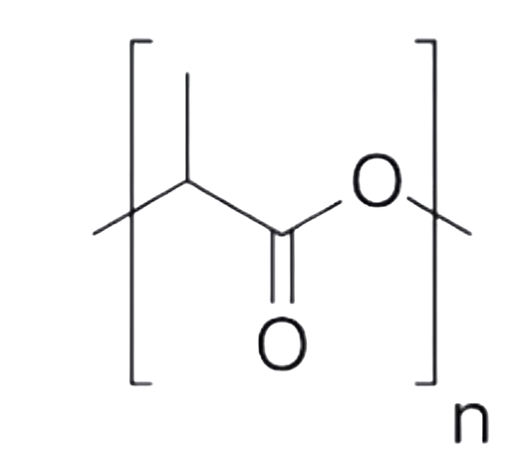
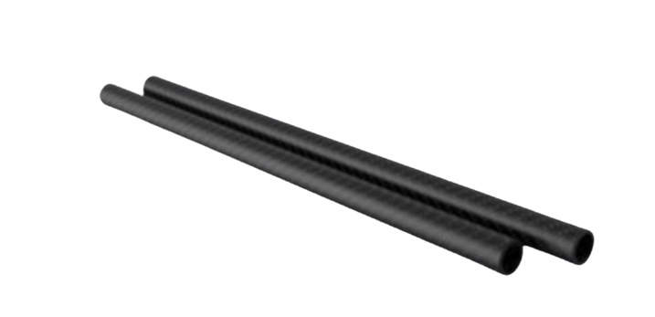
MATERIAL
Components | Material
Propeller | ABS
Main body | PLA+
Propeller Guard | PLA+
Landing Gear | Aluminum
Arms | Carbon Fibre
ABS
Carbon fibre
PLA+

Slide 6
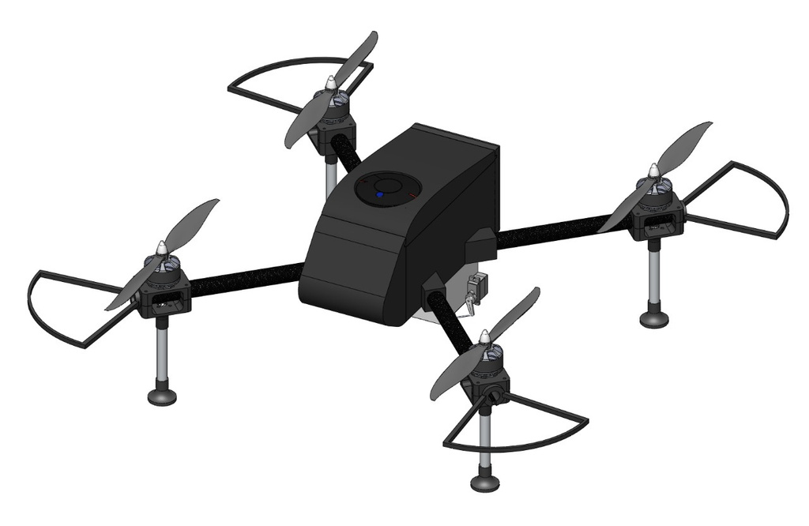
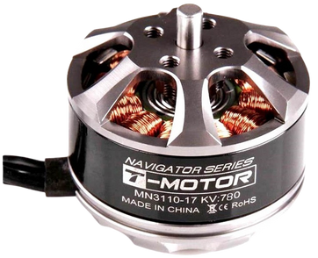
COMPONENTS
Brushless Motors
Brushless motors eliminate friction from brushes.
Reduces energy loss and improve efficiency.
Can achieve higher RPMs allowing for faster response and greater thrust.
High torque.
T Motor MN3110
TEAM PHOENIX AERO

Slide 7
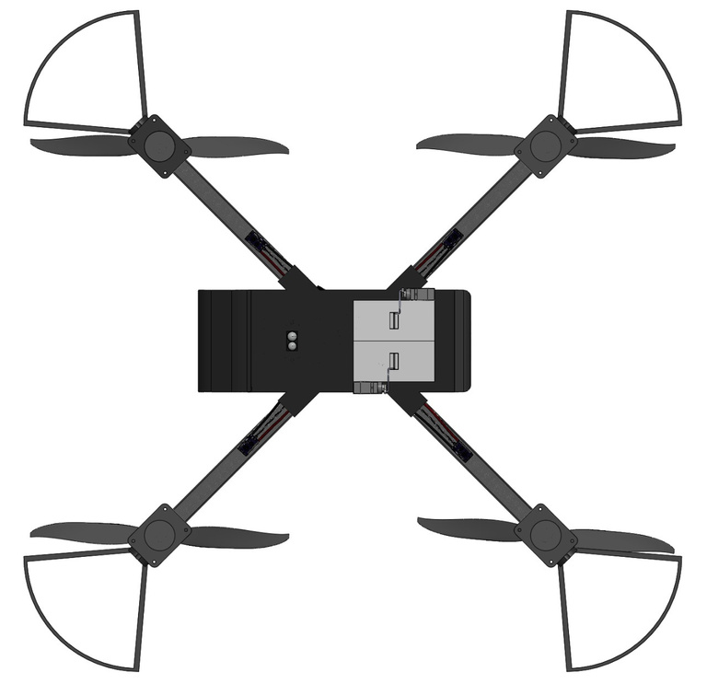
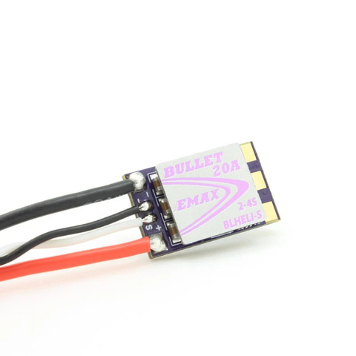
COMPONENTS
Electronic Speed Controller
Faster response to analog and PWM protocols
Reduced heat generation
Handles higher current load
Emax 35A BLHeli-S firmware
TEAM PHOENIX AERO
TEAM PHOENIX AERO

Slide 8
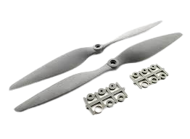
COMPONENTS
Propellers
Good balance of strength and flexibility
Relatively light-weight
Quieter operation
11X4.5 Inch Propellers
TEAM PHOENIX AERO

Slide 9
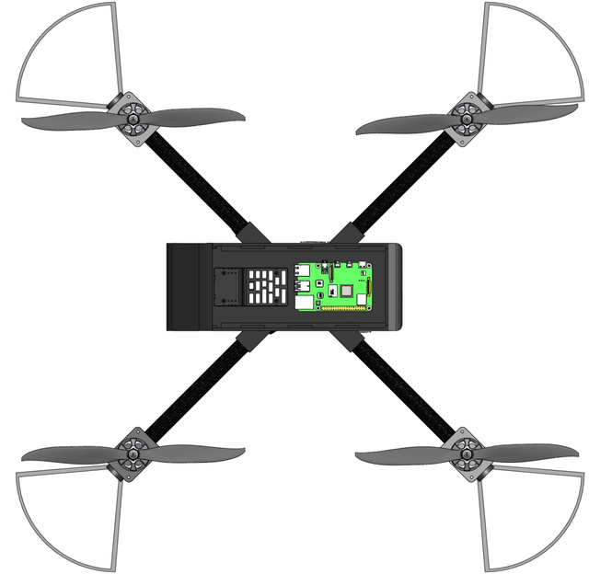
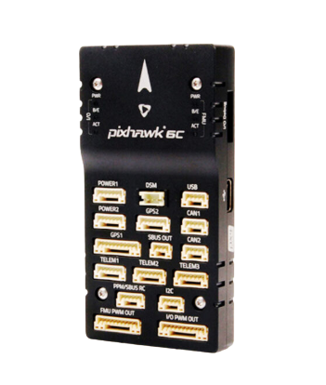
COMPONENTS
Flight Controller
Supports various flight modes.
Compact and light weight design
High processing power for sensor data fusion
Advanced power management capabilities
Pixhawk 6c
TEAM PHOENIX AERO
TEAM PHOENIX AERO

Slide 10
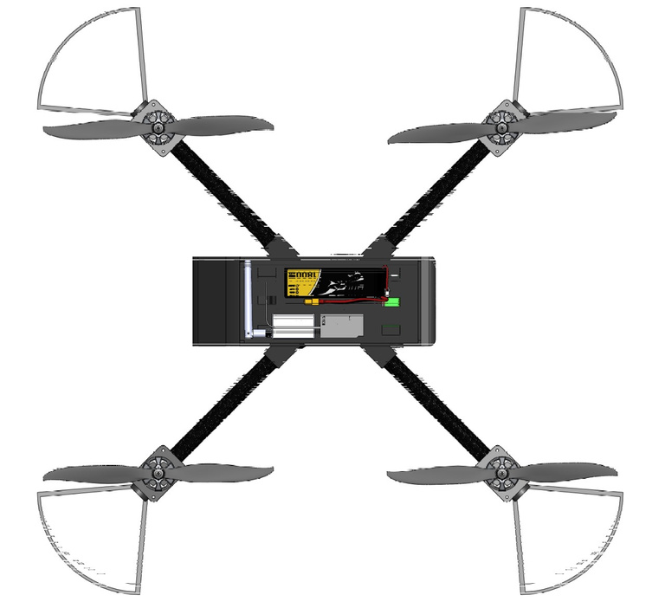
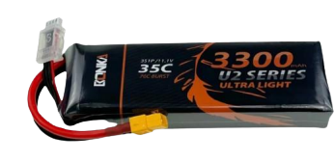
COMPONENTS
Battery
Longer flight time
Prevents overheating during high discharge
Higher energy density
Lesser internal resistance
Consistent power supply
3300 mAh Bonka
LiPo Battery
TEAM PHOENIX AERO

Slide 11
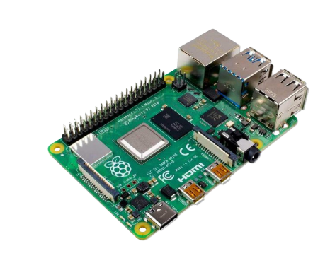
COMPONENTS
On-board Computer
Powerful processor
Multiple USB ports
Expandable memory
Multiple memory configurations
Compatible camera module
Raspberry pi 4b
TEAM PHOENIX AERO

Slide 12
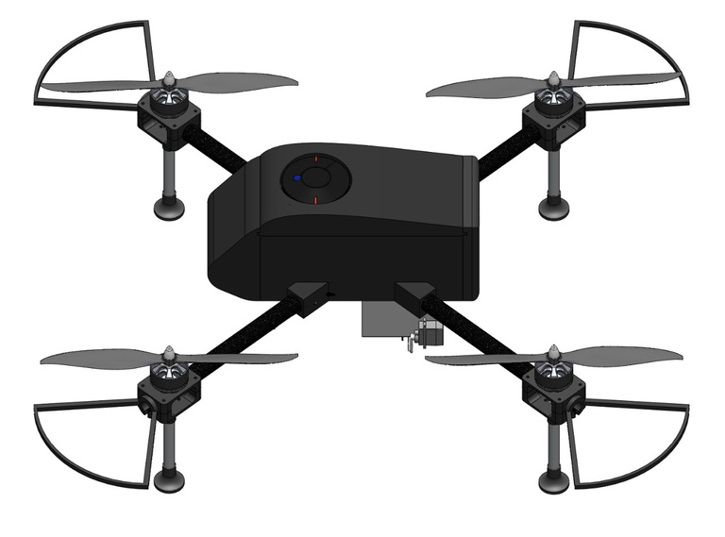
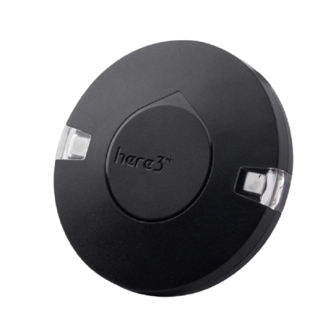
COMPONENTS
Global Positioning System
RTK HERE 3+ GPS provide horizontal accuracy within centimeters.
Support multiple GNSS constellation including GPS, GLONASS , Galileo and BeiDou for improved accuracy and reliability
RTK-GPS HERE3+
TEAM PHOENIX AERO

Slide 13
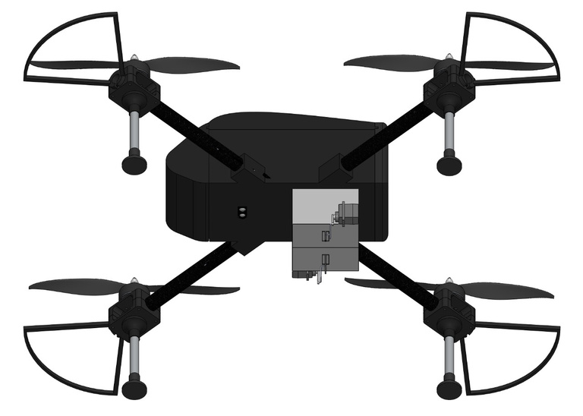
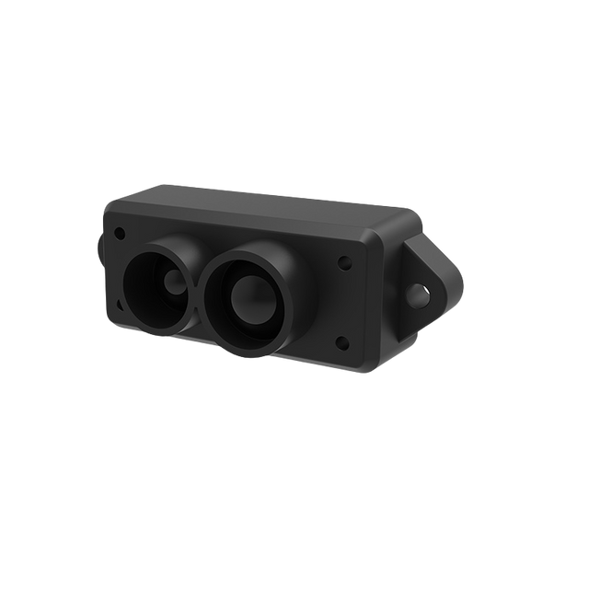
COMPONENTS
Lidar
Provide accurate distance measurement and obstacle detection.
Ensure drone stability during autonomous mission.
TF-Mini-S
TEAM PHOENIX AERO

Slide 14

TOTAL WEIGHT ESTIMATION
Sr No.
Name/Component
Quantity
Weight per Q (gm)
Weight
1
Battery & Power Modules
1
690
690
2
T-Motor
4
98
392
3
Frame & Rods (4)
1
52
265
4
Payload & Payload Mech.
1
160
160
5
Propellers & Guards
4
26
104
6
ESC
4
15
60
7
Flight Controller
1
60
60
8
Onboard Computer
1
52
52
9
GPS
1
51.8
51.8
10
Telemetry
1
24
24
11
Lidar
1
5.3
5.3
12
Camera
1
3
3
13
Miscellaneous
100
100
Total
21
982.9
1867.1
TEAM PHOENIX AERO

Slide 15
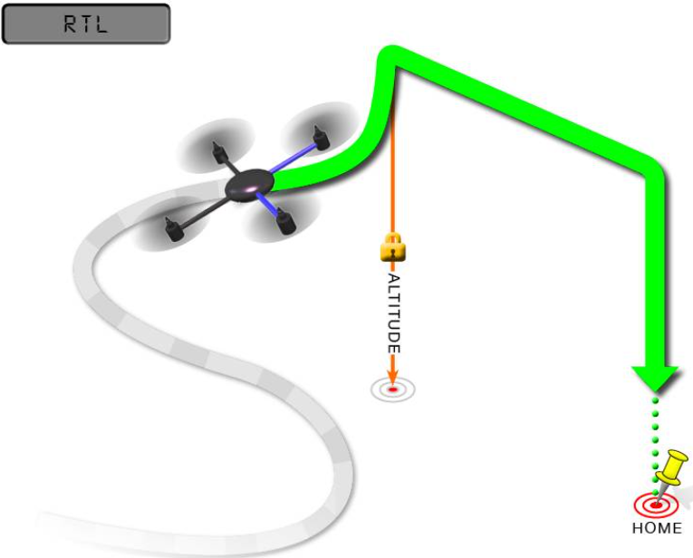
SAFETY FEATURES
Return to Launch (RTL)
A drone safety feature that automatically brings the drone back to its takeoff point if it loses signal or has low battery.
Using GPS, the drone follows a safe route to land at the exact launch location, preventing fly-aways and crashes.
TEAM PHOENIX AERO

Slide 16
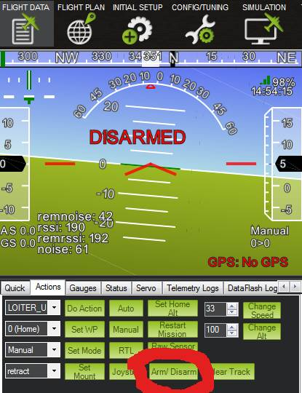
SAFETY FEATURES
Auto disarm
A drone safety feature that automatically disables the motors after a certain period of inactivity or upon landing.
It is especially useful in emergency situations or when the drone is idle for too long.
TEAM PHOENIX AERO

Slide 17

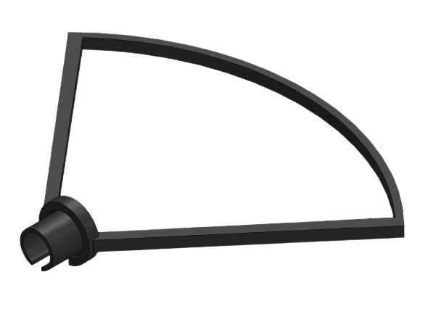
SAFETY FEATURES
Propeller guard
A propeller guard for drones is a protective frame around the propellers that prevents damage and enhances safety.
It protects people, objects and the drone itself from accidental contact while improving flight stability.
Propeller guard
TEAM PHOENIX AERO

Slide 18


MANUFACTURING
TEAM PHOENIX AERO

Slide 19
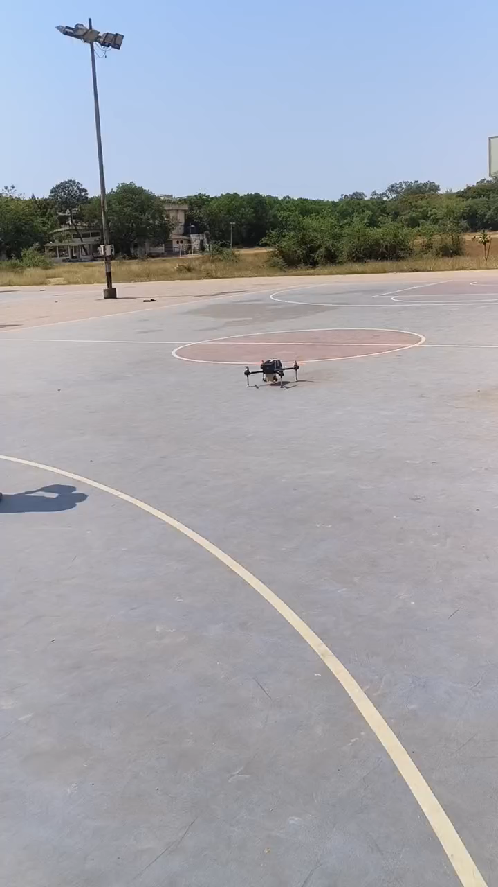
TESTING VIDEO
TEAM PHOENIX AERO

Slide 20
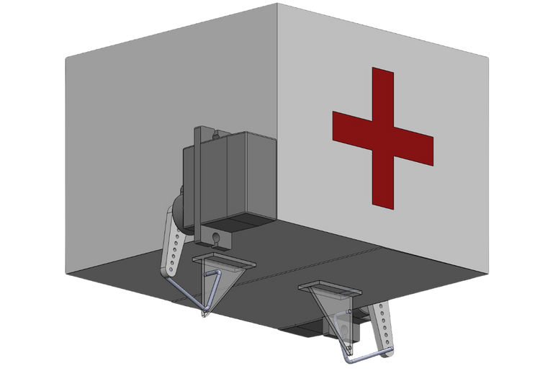
PAYLOAD BAY DESIGN
Stable and lightweight cubical structure optimized for strength and efficiency, made from durable materials like craft board and foam.
Hinged door with a controlled 90° opening to minimize impact forces on the payload.
Dual-servo mechanism ensures secure locking and smooth operation.
Auto-reset feature closes the door for the next use.
Payload Bay Design
TEAM PHOENIX AERO

Slide 21
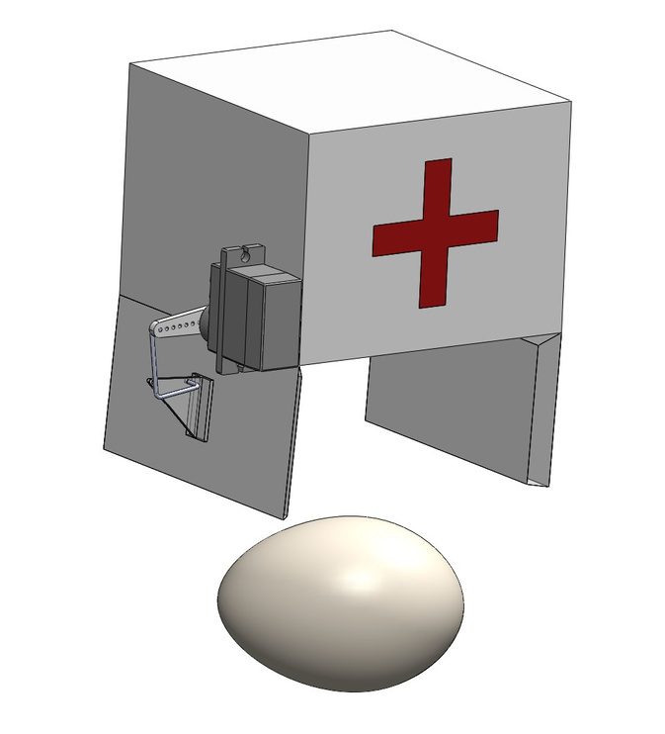
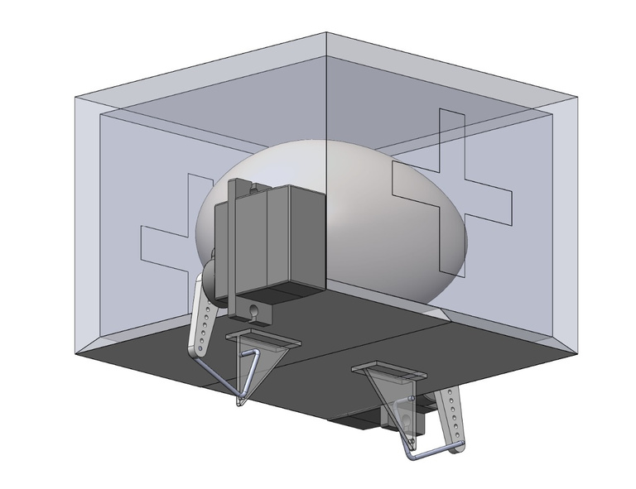
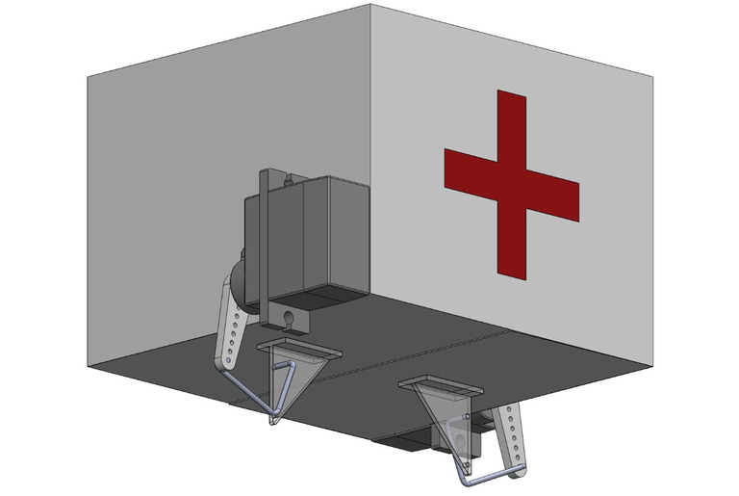
DROPPING MECHANISM
Payload Loaded
Payload Unloading
Payload Unloaded
TEAM PHOENIX AERO

Slide 22
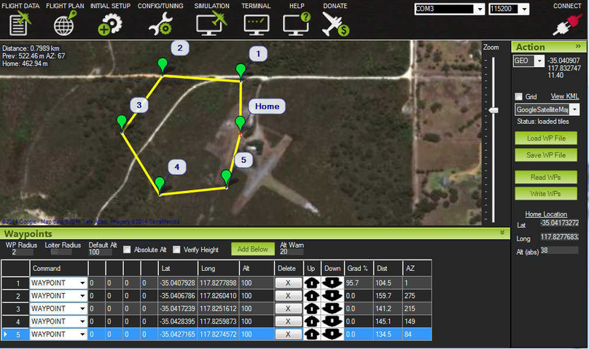
AUTONOMOUS MISSION
Initial Preparation – Setting up for the operation.
Defining GPS Coordinates & Planning Route – Determining the flight path.
Takeoff – Drone begins the mission.
Scanning for QR Code – Searching for a target QR code.
Three Possible Outcomes:
QR Code Not Detected → Drone proceeds to the destination.
Recognition at Destination → Retrieves data, hovers, and drops payload.
Recognition Before Destination → Proceeds with retrieval and precision hovering.
Payload Dropping – Delivering the package.
Returning to Launch Base – Mission completion.
Overall Autonomous mission planning on Mission Planner
TEAM PHOENIX AERO

Slide 23
QR CODE DETECTION
Take off
Scanning for QR code
QR code is not detected
Recognition of QR code at destination
Recognition of QR code before destination
Retrieval of the data in
the QR code.
Arrival at destination
Precision hovering over the QR code
Payload dropping
TEAM PHOENIX AERO

Slide 24
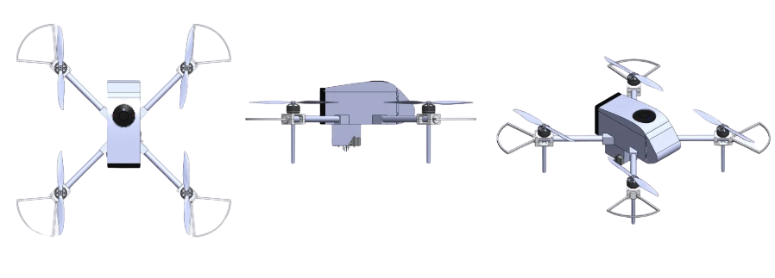
INNOVATION
Unique and Protective Drone Design
The quadcopter boasts a compact, aerodynamically shaped body that provides effective component placement.
The design focuses on weight saving, strength and improved performance.
Specially designed propeller guards offer maximum protection with least airflow obstruction.
Aerodynamic shape
TEAM PHOENIX AERO

Slide 25
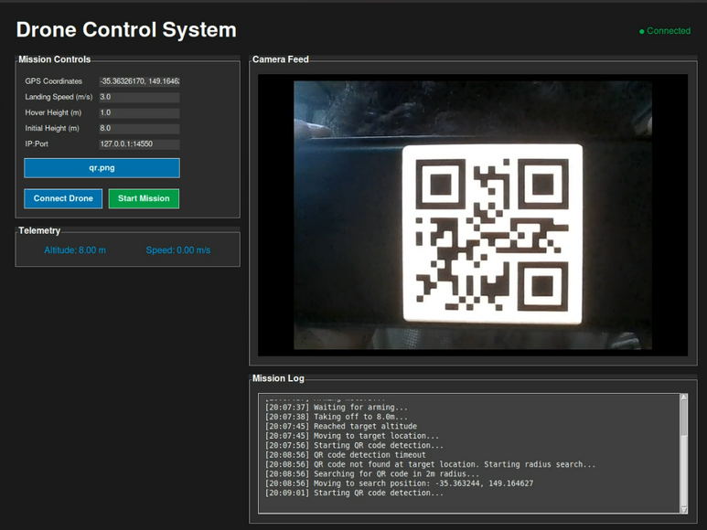
INNOVATION
Graphical User Interface (GUI)
A custom-built GUI simplifies mission planning for better user experience.
Features include mission planning, payload verification and drone connectivity .
Designed for ease of use in Indian markets, improving efficiency and security.
TEAM PHOENIX AERO

Slide 26
EVENT VIDEOS
(ROUND 1)
TEAM PHOENIX AERO

Slide 27
EVENT VIDEOS (ROUND 2)
TEAM PHOENIX AERO

Slide 28
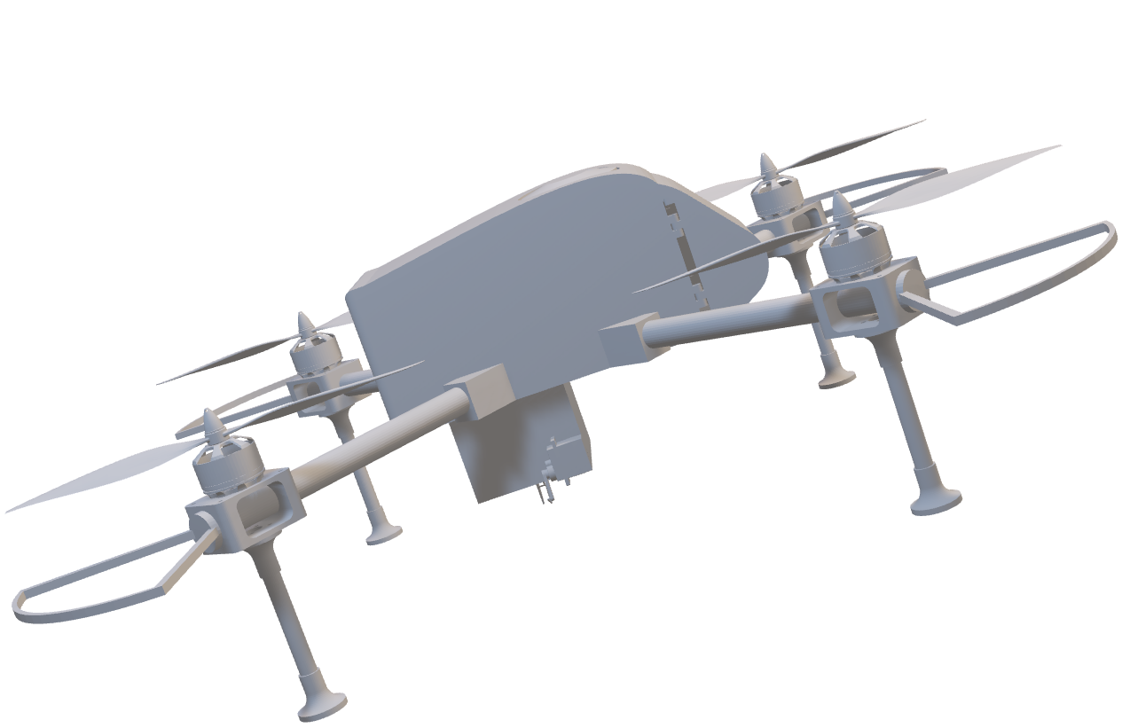
THANK YOU
TEAM PHOENIX AERO

